Slide 1


GitHub Repository Mining: An Experimental Journey with BERT
Iterative Optimization for Automated Domain Classification
Senior AI Research & Data Science Presentation
Notes:
Welcome. Today, I'll share our journey in GitHub repository mining using BERT-based text classification. We'll explore how iterative optimization led to a robust automated domain classification system. This presentation focuses on the experimental process and the insights gained. We'll cover the challenges and solutions in building an effective NLP pipeline. Now, let's dive into the iterative journey that shaped our final model.

Slide 2


Automating Domain Identification in the GitHub Ecosystem
Field Fusion Logic
Repository Description
The Problem
Manual understanding of millions of repositories is impossible. We need automated tagging for search and trend analysis.
[SEP]
README Content
The Solution
A BERT-based pipeline using DistilBERT (base-uncased) for efficient and high-performance inference on textual metadata.
Model Input Tensor
Core Strategy
Max Sequence Length: 512 Tokens
Iterative experimentation to handle small dataset constraints (~550 samples) and extreme class imbalance.
Notes:
The sheer scale of GitHub makes manual domain identification impossible. We needed an automated solution to categorize millions of repositories for better search and trend analysis. Our approach uses a BERT-based pipeline, specifically DistilBERT, for efficient and high-performance inference. The core strategy involved iterative experimentation to overcome small dataset constraints and extreme class imbalance. We fused repository descriptions and README content, separated by a special token, to create a rich input for the model. This holistic input, capped at 512 tokens, provides maximum context. Now, let's dive into the iterative journey that shaped our final model.

Slide 3

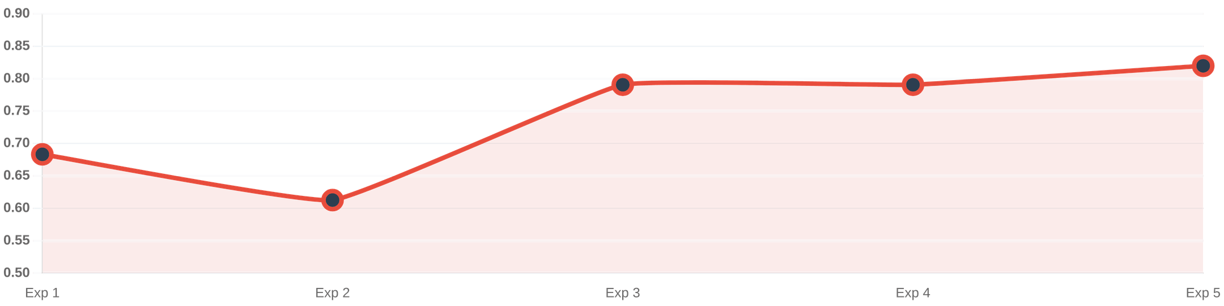
The Iterative Experiment Journey: Macro F1 Progression
Exp 1: Baseline
Exp 2: LoRA
Exp 3: Merging
Exp 4: Focal Loss
Exp 5: Final Best
5 Classes, standard BERT. Heavily biased toward AI.
PEFT trial. Underfitting due to small dataset size.
3 Classes + Weights. Significant jump in stability.
Stabilized training & reduced AI dominance.
Oversampling + Threshold Tuning. Peak F1: 0.8198.
Notes:
Our journey was a series of iterative experiments, each building on the last to improve Macro F1. We started with a baseline, quickly realizing the limitations of a standard BERT model on five imbalanced classes. Next, we explored LoRA, but it proved too restrictive for our small dataset. Merging classes was a pivotal step, significantly boosting stability and performance. Then, Focal Loss further stabilized training and balanced class representation. Finally, oversampling and threshold tuning brought us to our peak performance of 0.8198 Macro F1 and 0.8551 Accuracy. We'll now examine some of these critical experimental decisions in more detail.

Slide 4

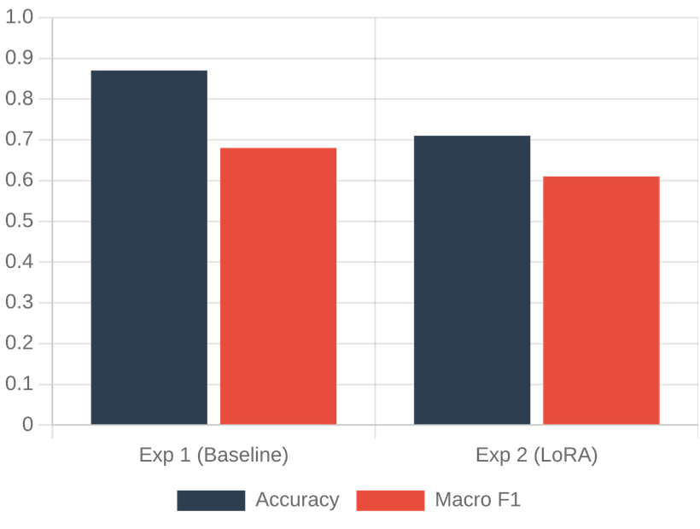



Why Accuracy is Misleading and LoRA is Not Always Best
Exp 1: The Accuracy Trap
87% Accuracy was misleading due to 57% AI class dominance. Macro F1 (0.68) exposed poor recall in Web and Data Science domains.
Exp 2: LoRA Constraints
Rank r=16 restricted model capacity too much for ~550 samples. Performance dropped (F1: 0.61) as the model failed to capture nuanced vocabulary.
Comparison: Accuracy vs. Macro F1
Key Takeaway
Full fine-tuning is necessary for small-scale datasets to ensure sufficient feature extraction and domain adaptation.
Notes:
Early on, we learned that accuracy can be misleading, especially with imbalanced datasets. An 87% accuracy in our first experiment masked poor recall in minority classes, highlighted by a Macro F1 of only 0.68. We also experimented with LoRA, hoping for parameter efficiency. However, for our small dataset of around 550 samples, LoRA's rank 16 restricted the model's capacity too much. This led to underfitting and a performance drop to 0.61 F1. The key takeaway here is clear: for small-scale datasets, full fine-tuning is often necessary to allow the model to extract sufficient features and adapt to the specific domain. This insight directly informed our next strategic move.

Slide 5


Reducing Variance through Targeted Class Consolidation
CLASS MAPPING
Original (5)
Merged (3)
AI + Data Science
AI & Data Science
Web + DevOps
Web & Infrastructure
THE STRATEGY
Mobile
Mobile
Merged Data Science into AI and DevOps into Web to increase per-class support and reduce model confusion.
WEB CLASS RECALL IMPROVEMENT
THE RATIONAL
0.60
0.68
Small dataset (~550 samples) led to high variance in minority classes. Consolidation provided more stable semantic patterns for DistilBERT.
Larger support for minority classes significantly reduced performance variance.
Notes:
To address the high variance in minority classes, we implemented a strategic class consolidation. We merged Data Science into AI and DevOps into Web, reducing our five classes to three. This decision was crucial because our small dataset of approximately 550 samples led to unstable semantic patterns for DistilBERT. By consolidating, we increased the per-class support, providing the model with more stable and robust patterns to learn from. This targeted merging significantly improved recall for classes like Web, moving from 0.60 to 0.68. This consolidation was a critical step in stabilizing our model's performance. Next, we'll explore how we further stabilized training.

Slide 6


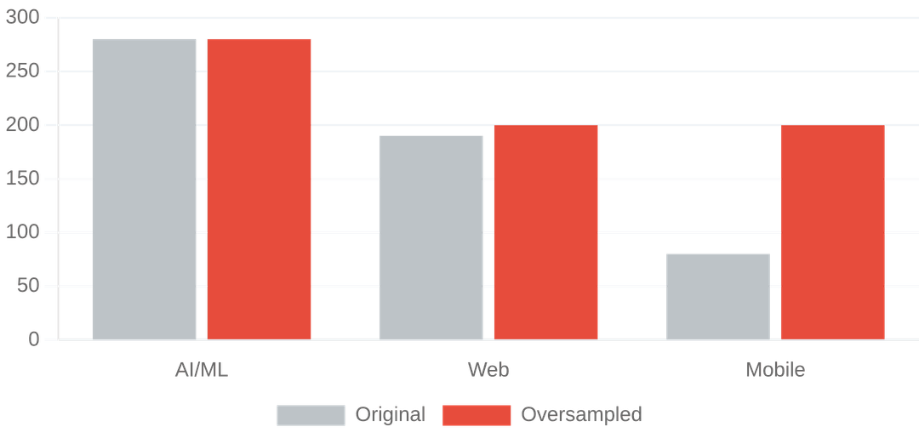


Stabilizing Training with Focal Loss and Random Oversampling
Random Oversampling (Exp 5)
Addressed pattern scarcity by raising Mobile and Web classes to 200 training samples each.
Focal Loss (Exp 4)
Replaced standard CrossEntropy with Focal Loss (gamma = 2.0) to down-weight easy examples and focus on hard-to-classify minority samples.
FL(pt) = -(1-pt)^γ log(pt)
Threshold Tuning
Training Sample Distribution (Before vs. After Oversampling)
Optimized classification thresholds on the validation set to maximize Macro F1, significantly improving minority class recall.
Notes:
To further stabilize training and boost minority class performance, we moved beyond basic class weighting. We implemented Focal Loss, which down-weights easy examples, forcing the model to focus on those harder-to-classify minority samples. We also strategically oversampled our minority classes, specifically Mobile and Web, to address pattern scarcity. This increased their representation in the training data, providing the model with more examples to learn from. Finally, we tuned classification thresholds on the validation set to maximize Macro F1, significantly improving minority class recall. This comprehensive approach directly tackled the challenges of imbalanced data and limited samples. Now, let's look at how these techniques collectively impacted our model's performance.

Slide 7

Comparative Analysis of Experimental Outcomes
EXPERIMENT
MAIN TECHNIQUE
MACRO F1
ACCURACY
KEY INSIGHT
1. Baseline
Standard DistilBERT
0.6832
0.8700
Heavily biased toward majority AI class.
2. LoRA Trial
PEFT (r=16)
0.6126
0.7100
Reduced capacity led to underfitting.
3. Merged
3-Class Strategy
0.7906
0.8286
Class consolidation improved stability.
4. Focal Loss
Gamma = 2.0
0.7906
0.8286
Reduced majority class gradient dominance.
5. Final Best
Oversampling + Tuning
0.8198
0.8551
Best balance of precision and recall.
Conclusion: The final model achieved a 20.0% improvement in Macro F1 over the baseline by shifting focus from raw accuracy to class-balanced performance.
Notes:
Building on our previous efforts, this slide summarizes the outcomes of our experimental journey. The final model achieved a significant 20.0% improvement in Macro F1 over our initial baseline. This table clearly shows how each technique contributed to refining our model, moving from a heavily biased baseline to a more balanced and robust classifier. It highlights that our focus shifted from raw accuracy to achieving a better balance of precision and recall across all classes, especially the minority ones. Let's dive deeper into why our final model truly won.

Slide 8


Superior Recall and Balanced Confusion Matrix
Final Model Confusion Matrix
AI/ML
Web
Mobile
AI/ML
0.89
0.07
0.04
0.8198
Web
0.10
0.83
0.07
FINAL MACRO F1
Mobile
0.05
0.13
0.82
85.5%
STABLE ACCURACY
Key Success:
Final accuracy reached 85.5% while maintaining a
The final model achieved the best balance by prioritizing minority class recall through oversampling and threshold tuning, reaching a peak F1 of 0.8198.
high Macro F1, proving the effectiveness of the iterative data-centric
strategy.
Notes:
Our final model truly excelled by prioritizing recall for the minority classes, a direct result of our oversampling and threshold tuning efforts. We achieved a Macro F1 of 0.8198 while maintaining a stable accuracy of 85.5%. The confusion matrix here illustrates this success: notice how Mobile recall improved significantly to 0.82 without compromising the strong performance of the majority AI/ML class. This balance was critical for real-world applicability, ensuring our model doesn't just perform well on the most common categories. This journey provided several key engineering lessons.

Slide 9





Key Takeaways from the Model Improvement Journey
ACCURACY IS A TRAP
DATA > ARCHITECTURE
In imbalanced datasets, high accuracy often masks poor minority class performance. Always prioritize Macro F1.
Strategic class merging and oversampling outperformed complex architectural changes like LoRA for this scale.
SMALL DATA CONSTRAINTS
ITERATIVE TUNING
Post-processing steps like Threshold Tuning provide high ROI for improving recall without retraining.
"Engineering decisions are driven by metrics, not just intuition."
Parameter-efficient tuning (PEFT) can underfit on very small datasets; Full Fine-Tuning is often necessary.
Notes:
Our journey provided several key engineering lessons, reinforcing that decisions must be data-driven. First, we learned that accuracy can be a misleading metric in imbalanced datasets; Macro F1 is a far better indicator of true performance. Second, for our small dataset, strategic data manipulation like class merging and oversampling proved more effective than complex architectural changes like LoRA. This shows that parameter-efficient tuning isn't always the best choice for very small datasets, where full fine-tuning might be necessary. Finally, post-processing steps like threshold tuning offered a high return on investment, significantly improving recall without requiring extensive retraining. Let's conclude with our future plans.

Slide 10





CONCLUSION
Future Roadmap
Scaling BERT-Based Mining for Real-World Tech Stack Analytics
CodeBERT Integration
Transitioning from text-only metadata to multi-modal analysis of actual source code files.
Multi-Label Support
Enabling repositories to belong to multiple domains for more realistic ecosystem mapping.
Metadata Fusion
Incorporating stars, forks, and language distributions into the feature set for higher precision.
Iterative refinement through Focal Loss, Oversampling, and Threshold Tuning transformed a biased baseline into a robust 0.8198 Macro F1 classifier.
Dataset Scaling
Expanding to 10,000+ samples to leverage larger Transformer models like RoBERTa.
"The journey proves that data-centric strategies often outperform architectural complexity in small-scale NLP tasks."
Notes:
In conclusion, our iterative refinement process, leveraging Focal Loss, oversampling, and threshold tuning, transformed a biased baseline into a robust 0.8198 Macro F1 classifier. This journey underscores that data-centric strategies often outperform architectural complexity in small-scale NLP tasks. Looking ahead, we plan to integrate CodeBERT for multi-modal analysis, moving beyond just text to analyze actual source code. We also aim to expand to multi-label support, allowing repositories to belong to multiple domains, and incorporate more metadata like stars and forks for even higher precision. Ultimately, scaling our dataset to over 10,000 samples will allow us to leverage larger Transformer models like RoBERTa, further enhancing our capabilities.

